Slide 1

Lab 4
CS 418: Interactive Computer Graphics
UNIVERSITY OF ILLINOIS AT URBANA-CHAMPAIGN
Eric Shaffer

Slide 2
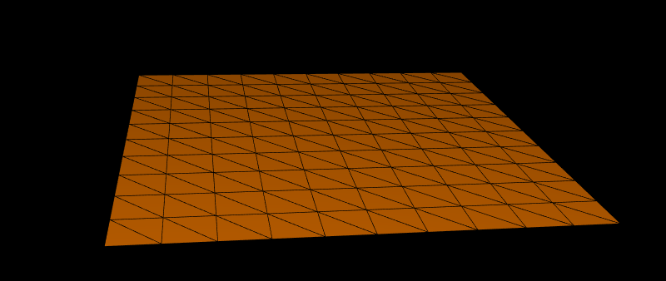
Generating a Terrain
Today, we will generate a flat triangulated mesh
This can be the start of your code for MP 2

Slide 3
Creating a Terrain Class
We will create a JavaScript class for our terrain
It will be rendered using the drawElements method
We will need to generate three buffers
A buffer of the vertex positions
A buffer of the triangles, specified by vertex indices
A buffer of normal vectors
Each vertex will have a normal vector associated with it

Slide 4
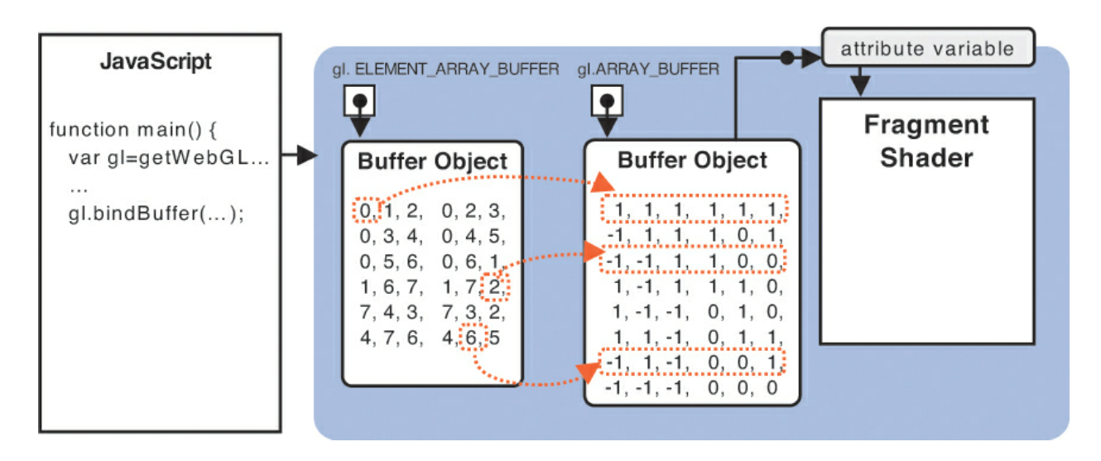
drawElements in WebGL
Any guesses as why the array buffer shows 6 numbers for each vertex?

Slide 5
drawElements in WebGL
Any guesses as why the array buffer shows 6 numbers for each vertex?
It’s storing a position and color together and sending both down to something like: attribute vec3 posAndColor[2];

Slide 6
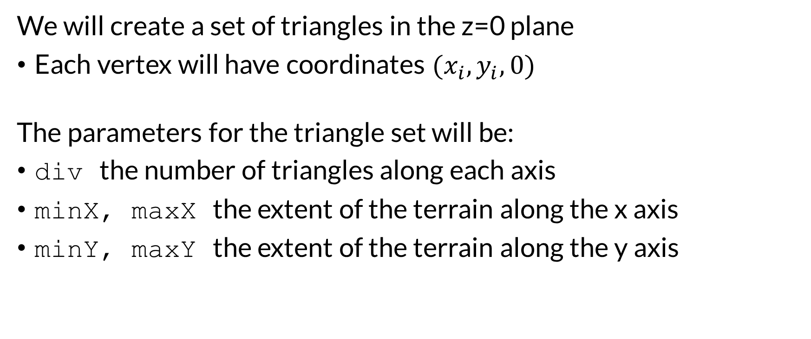
The Terrain Geometry
We will create a set of triangles in the z=0 plane
Each vertex will have coordinates ${(x}_{i},y_{i},0)$
The parameters for the triangle set will be:
div the number of triangles along each axis
minX, maxX the extent of the terrain along the x axis
minY, maxY the extent of the terrain along the y axis

Slide 7
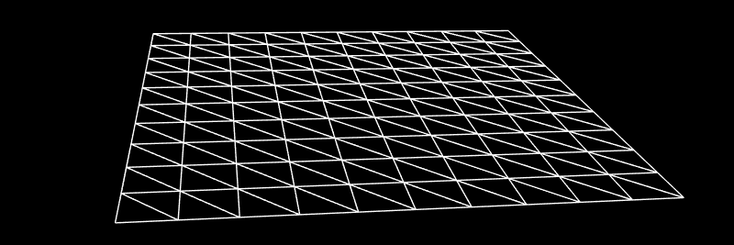
Terrain Geometry
div the number of triangles along each axis
minX, maxX the extent of the terrain along the x axis
minY, maxY the extent of the terrain along the y axis
Vertex (i,j) is in the ith row and jth column
with i,j in the range [0,div]
Generate it so that (0,0) is the first vertex with coordinates (minx,minY,0)
What are the indices of the faces?
How many total vertices?
How many total triangles?

Slide 8
Your Tasks
For this lab write the following functions in the terrain.js file
getVertex
setVertex
generateTriangles

Slide 9
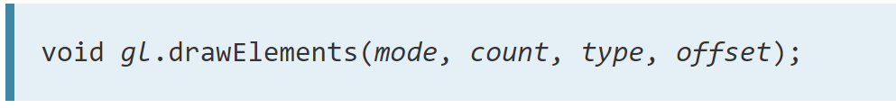
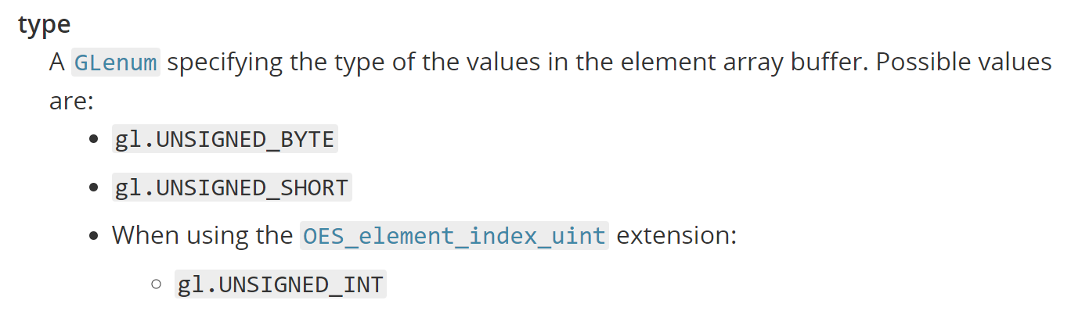
Indexing with drawElements
In WebGL 1.0 you are limited to using 2-byte integer indices
How may vertices could you index?
There’s an extension to let you use 4-byte integer indices
Need to initialize/check with var ext = gl.getExtension('OES_element_index_uint');

Slide 10
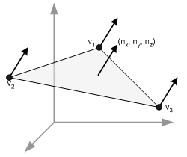
Computing Normal Vectors
For shading you need per vertex normal
Vertex buffer contains N vertices with x,y,z coordinates
So 3N floating point numbers
Normal buffer will contain N normals with x,y,z So 3N floating point numbers
The Kth vertex will start at location 3(K-1) in the buffer The normal for vertex K will start at location 3(K-1)
What are the normal vectors for the terrain in this lab?
How would you compute them in general?

Slide 11
Computing Normal Vectors
What are the normal vectors for the terrain in this lab?
For the flat terrain, they all would start as (0,0,1)

Slide 12
Computing Normal Vectors
How would you compute them in general?
Write a function generateNormals() that does the following
To compute per-vertex normal on a mesh with M vertices
Initialize an array NArray containing M normals
Each normal starts as [0,0,0]
Iterate over all triangles T=[v1,v2,v3] with vi in CCW order
Compute normal N for T using N = (v2-v1)X(v3-v1)
NArray[v1]+=(Narray[v1]+N)
NArray[v2]+=(Narray[v2]+N)
NArray[v3]+=(Narray[v3]+N)
Normalize each normal in Narray to unit length

Slide 13
The Shader
The shader code you have been given implements
Phong reflection model
Gouraud shading
This generates a color per-vertex in the vertex shader
It does not implement Phong shading

Slide 14
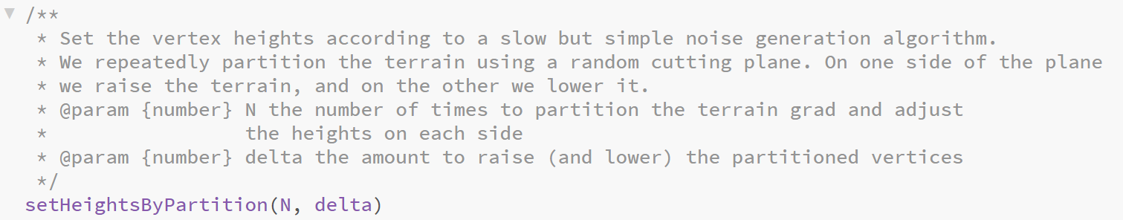
One More things for MP 2
You’ll need to implement…..
…which we won’t do in this Lab exercise….

Slide 15
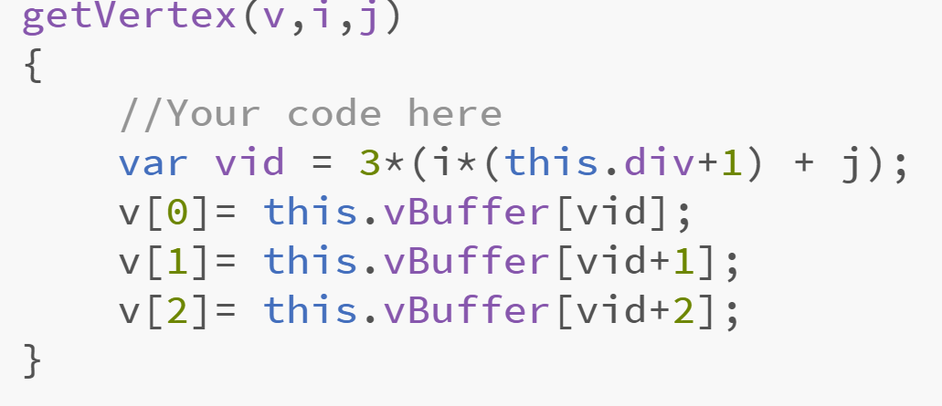
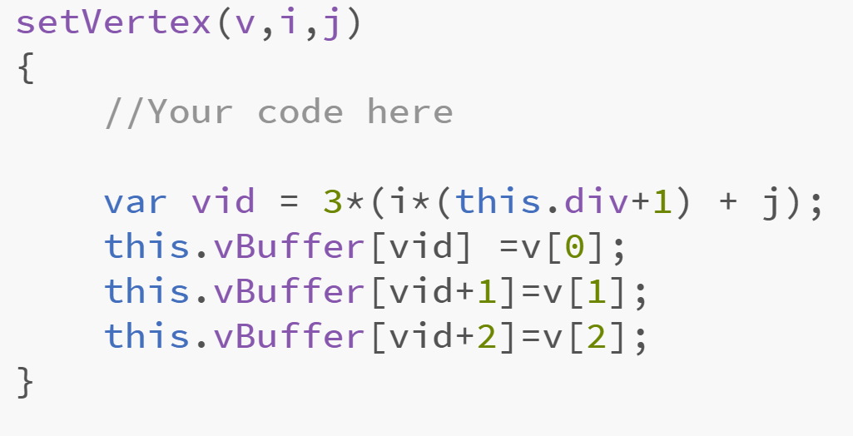
Lab Solution
One possible solution

Slide 16
